Slide 1
Tour de France
Data analysis

Slide 2
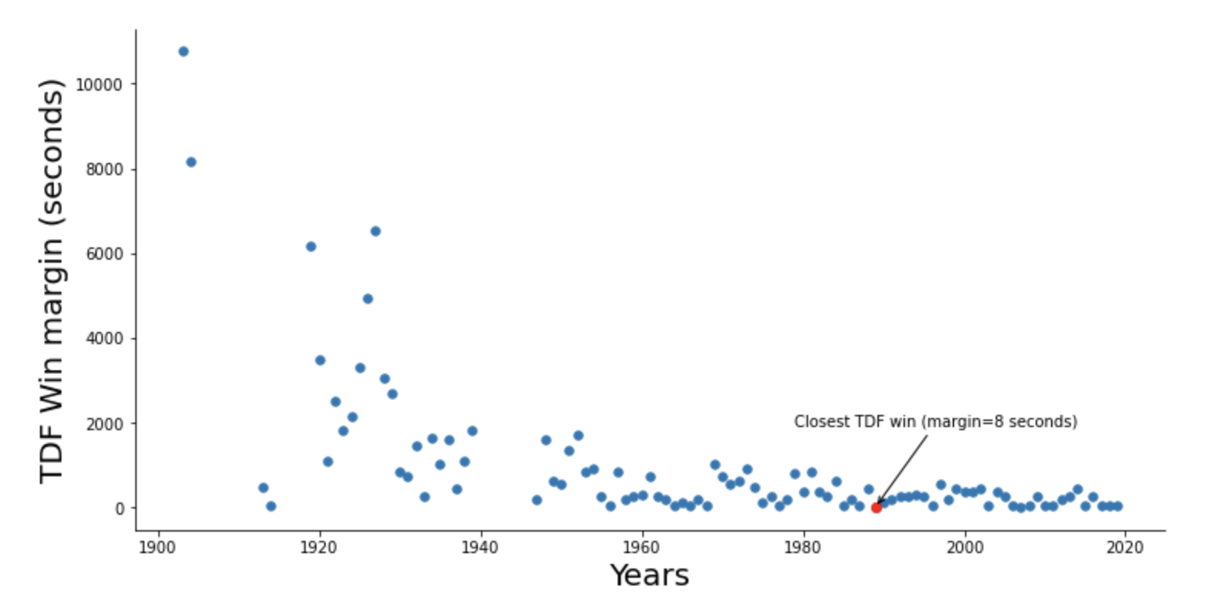
TDF Win margin by the years.
Winning margin decreased significantly in 30th and less significantly in 50th. Last 30 years the Win margin close to minimum (below 1 minute).

Slide 3
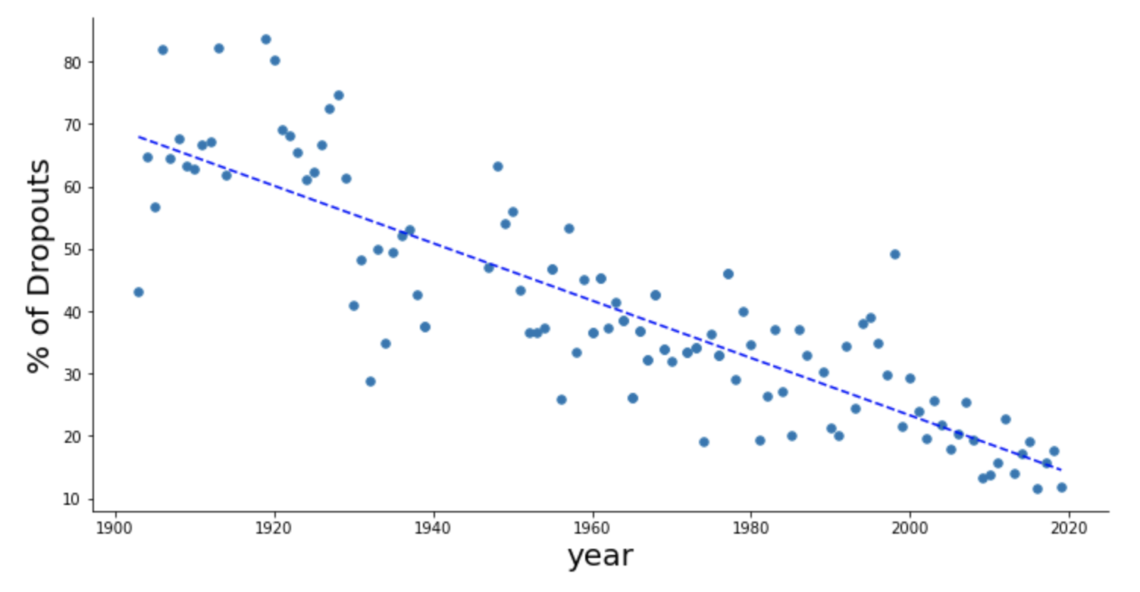
Percent of dropouts by years.
Strong trend of reduce of dropout riders. We can conclude that most proficient riders participate in the competition.

Slide 4
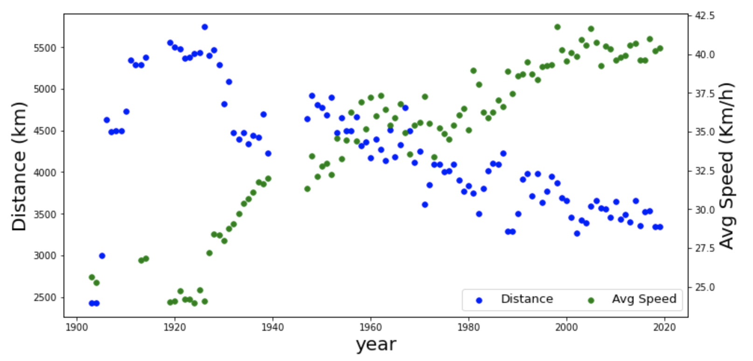
Correlation between the distance and the average speed over the years.
The distance become shorter over the years that allow to increase average speed.

Slide 5
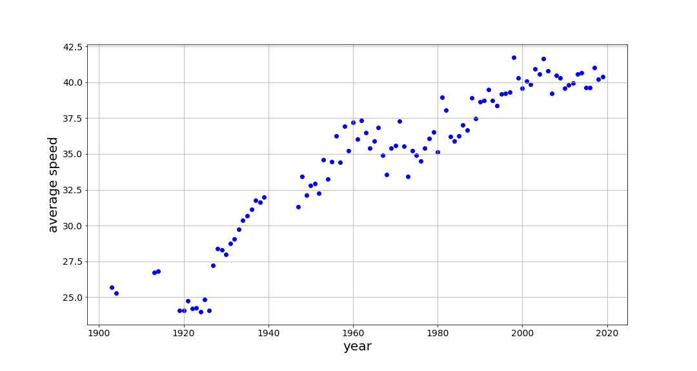
Winners average speed.
We can see significant increase in 20^{th-}- 40th. The reason of this increase could explain by changing the rule in 1927.

